Slide 1

EduCom: Educational Connectivity
Supervisor: Asim Riaz
Anmol Kumari – 2212141
Pawan Mahesh – 2212263
Delivered To Panel 4: Ali Mobin(TL), Usama Khalid, Waqar Malik, Samar Yazdani

Slide 2
Section 1 / 10
Introduction: Bridging the Communication Gap
Current System Overview
The Missing Link
Project Aim
There is a critical lack of a unified, institution-wide internal communication channel tailored specifically for academic needs and role-based access.
To develop a secure, real-time platform that streamlines communication and establishes clear, dedicated pathways for all academic stakeholders.
SZABIST currently relies on a fragmented mix of channels, leading to inconsistent communication delivery and potential information silos.

Slide 3




Section 2 / 10
Problem Statement: The Cost of Fragmentation
Ineffective Communication Methods
Efficiency Loss and Fragmentation
Over-reliance on general tools like WhatsApp and email, alongside limited platforms like ZABDESK, results in information overload and critical messages being missed.
Miscommunication and the scattering of crucial data across different systems severely impact administrative and academic efficiency.
Privacy and Feedback Deficits
Existing channels lack privacy controls and robust, structured mechanisms for anonymous feedback, hindering honest dialogue.

Slide 4

Section 3 / 10
The Strategic Rationale: Why Build This Platform?
Structured Real-Time Communication
Need for Genuine Feedback
Traditional systems cannot support the demand for instant, structured, and organized dialogue required in a dynamic academic environment.
Current feedback mechanisms lack anonymity, leading to self-censorship. The platform ensures authentic student and faculty voices are heard.
Academic Integrity and Governance
Digital Transformation Imperative
The rising need for AI-powered moderation and reporting tools to proactively maintain professional conduct and academic integrity in digital channels.
This project aligns with the broader institutional goal of advancing digital infrastructure and modernizing core operations.

Slide 5



Section 4 / 10
Target Industry and Scalability
Primary Focus: Education
Sector: Information Technology
Future Scalability
Built with modularity, the platform offers significant potential for adoption by other universities and educational bodies worldwide, extending its impact beyond SZABIST.
The platform is meticulously designed to meet the unique structural and functional requirements of higher academic institutions, specifically SZABIST.
Leveraging modern IT infrastructure and robust security protocols to ensure a stable, high-performance, and maintainable application.

Slide 6



Section 5 / 10
Competitive Advantage: Beyond Standard Systems
The SZABIST Communication Platform integrates several key features that distinguish it from existing, siloed communication methods.
Centralized Nexus
Anonymous Feedback
Socket.io Real-Time
One dedicated space for all communication across students, faculty, and administration.
Secure channel for sensitive reports and honest course/service reviews.
Instantaneous, low-latency messaging essential for urgent announcements and interactions.
AI Moderation (NLP)
PWA Deployment
Automated content filtering and flagging to ensure a respectful and professional environment.
Accessible via any web browser, offering a native app feel without installation barriers.

Slide 7
Section 6 / 10
FYP-I Overview: Establishing the Foundation
The first phase focused on building the core structural integrity, foundational database, and essential administrative modules.
Database Schema & Setup
1
Designing and implementing the robust relational database to handle structured academic data.
2
Role-Based Authentication
Developing secure login systems (Frontend & Backend) to enforce strict access control for students, faculty, and administrators.
Admin Management System
3
Creating the dashboard for user management, role assignment, and system configuration.
4
Core Community Channels
Initial development of public and private channels necessary for group communication.
User Profile Management
5
Admins can view and update their basic profile information
(name, email, Contact)

Slide 8





Section 7 / 10
FYP-II Overview: Advanced Modules & AI Integration
The second phase transitions to advanced functionality, focusing on real-time communication, user engagement, and intelligent moderation.
Real-Time Messaging
Full implementation of Socket.io for instantaneous, live interactions within all active channels.
Anonymous Feedback & Reports
Finalizing the secure, untraceable mechanism for submitting complaints and suggestions.
AI-Based Content Moderation
Integrating Natural Language Processing (NLP) models for automated detection of inappropriate content.
Email Notification Integration
Automatically sends alerts and updates to users for important events such as announcements, feedback responses, and account activities.
Payment Integration
Enables secure online transactions within the platform for purchasing educational materials or marketplace items.

Slide 9
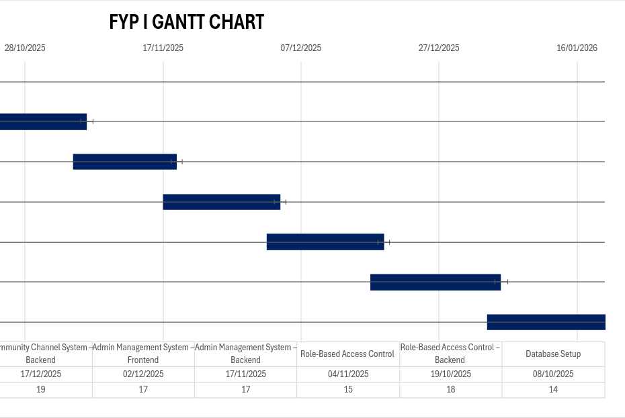
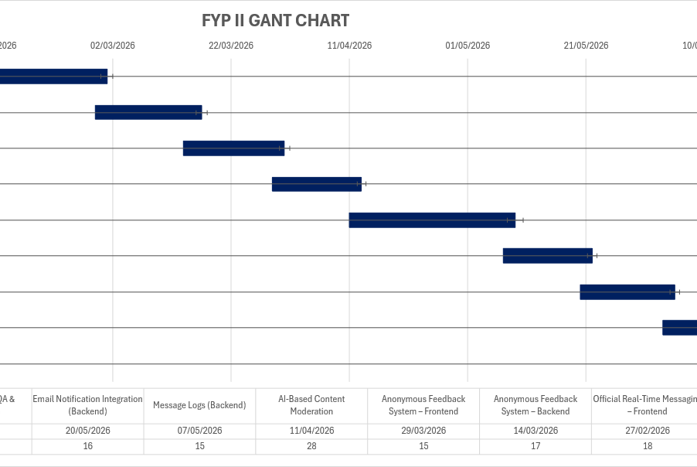
Gantt Chart
Sections 8 / 10

Slide 10
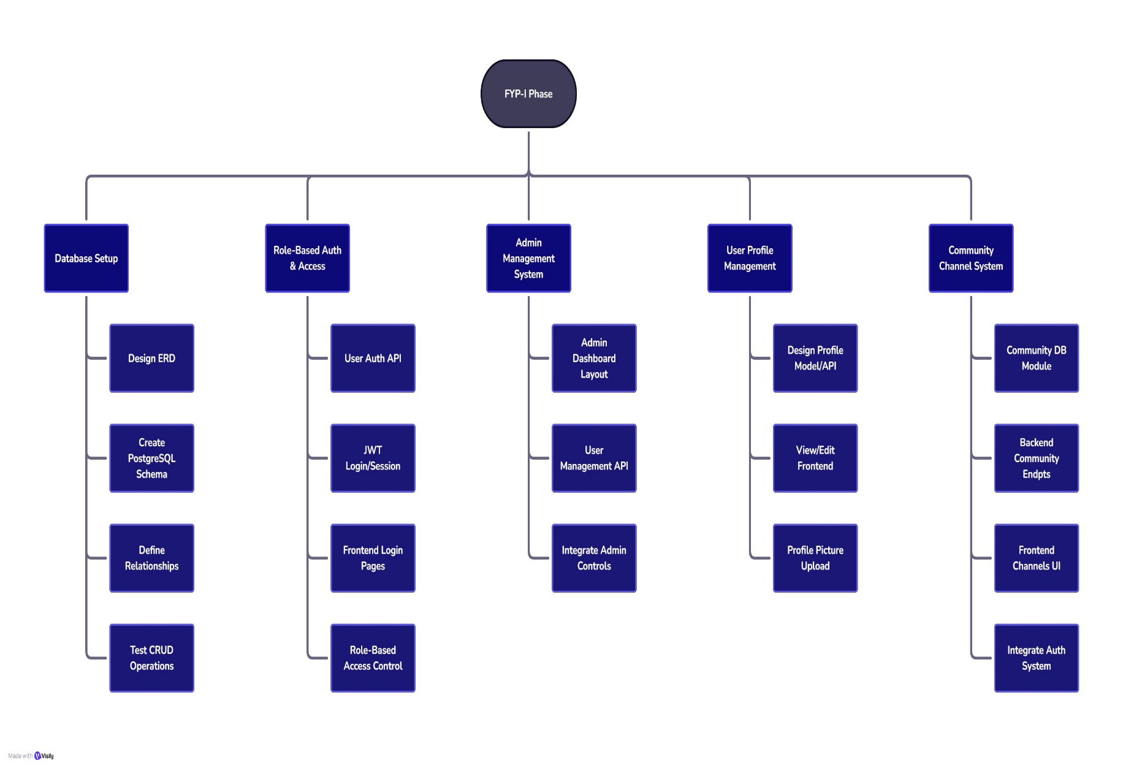
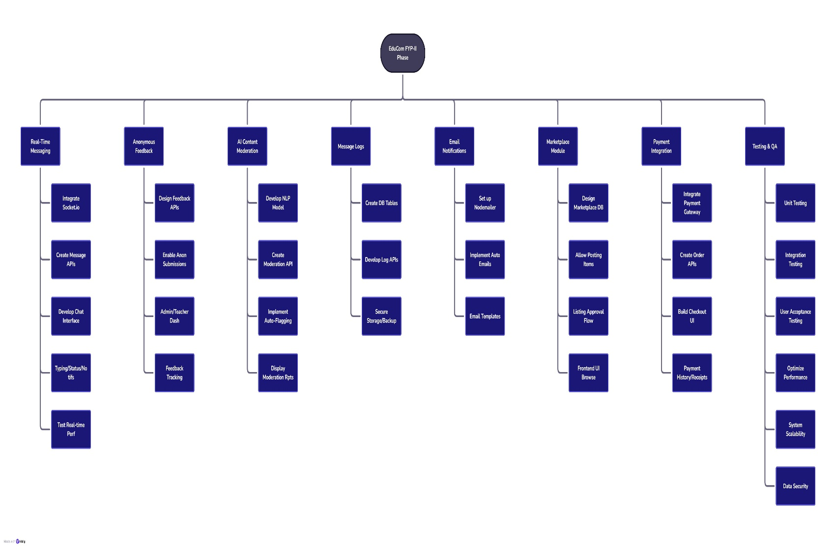
WBS Visualization
Sections 9 / 10

Slide 11








Section 10 / 10
Conclusion: Strengthening SZABIST's Digital Future
Enhanced Communication
Institutional Transparency
A single source of truth for all academic discourse, eliminating fragmentation.
Structured feedback and clear communication paths build trust.
Academic Efficiency
Technological Innovation
Improved data flow and real-time alerts boost administrative and teaching efficacy.
Integration of AI and real-time technology sets a new standard for campus platforms.
The SZABIST Communication Platform is a vital step toward digital transformation, providing a modern, secure, and intelligent environment for all campus stakeholders.

